Slide 1

CSE322 Big Data analytics 1
IPL Data Analytics Using Apache Spark
Under the supervision of : Dr. Heba Allah Sayed

Slide 2
Team members :
Mohamed Rady Salah 222200004
Mohamed Elsayed Nagy 222200002
Shrouq Hesham salman 223108628
Rawan Hesham 221100803

Slide 3
Introduction
Why Apache Spark for IPL Analytics?
Apache Spark is a unified analytics engine designed for fast, large-scale data processing.
We applied PySpark to IPL datasets to derive valuable insights from over 150,000 records.
Real-time performance and scalability made Spark ideal for this sports analytics use case.

Slide 4
Technologies and Tools
Stack Overview
Apache Spark (PySpark): Distributed computing framework
Python: Programming logic and transformation
Jupyter Notebook: Interactive data analysis environment
Pandas & Matplotlib: Visualization and simple aggregation

Slide 5
About the Datasets
IPL Data Summary:
Matches.csv: 750+ records about match-level
Informationdeliveries.csv: 150,000+ ball-by-ball delivery
RecordsData includes teams, players, runs, wickets, venues, and moreDatasets were joined and cleaned for smooth analysis

Slide 6
Data Preprocessing
Cleaning and Preparing the DataContent:
Null values removed and schemas correctedSpark DataFrames
Used for distributed transformationsMatches and deliveries
Datasets joined via match IDColumns renamed for readability and consistency

Slide 7
Key Questions Explored
What We Wanted to Discover:
Which team has the highest number of wins?
Who are the top-performing batsmen and bowlers?
What is the most common dismissal method?
Does winning the toss impact match results?
What are the highest scoring venues?

Slide 8
Apache Spark Components Applied
Spark SQL: Used for complex aggregations
RDDs: For fault-tolerant, distributed data operationsDataFrame
API: High-level transformations
Cluster Manager: Efficient resource allocation (Standalone mode used)

Slide 9
Key Features of Apache Spark
Speed & Performance: In-memory processing for faster computations (highlight comparison with traditional disk-based systems)
Unified Platform: Batch, Streaming, Machine Learning, and Interactive Analysis on a single platform.
Ease of Use: Simple APIs (Spark SQL, PySpark, RDDs) for familiar programming languages (Java, Python, Scala).
Fault Tolerance: Handles failures and recovers automatically, ensuring reliable data processing.

Slide 10
Benefits of Apache Spark
Faster processing times for big data analytics.
Cost-effective by utilizing existing cluster infrastructure
Scalable to handle growing data volumes.
Streamlines development with familiar programming models.

Slide 11
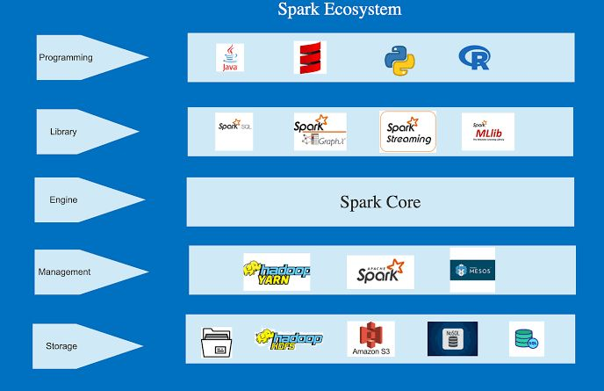
The Spark Ecosystem :
Spark eco-system consists of three parts:
Spark services:
SQL: structured data
Streaming : data handling
ML: machine learning
Graph X : graph computations

Slide 12
2. Spark Core:
computational engine .
Basic Functionality of spark .
Responsible for scheduling , distributing and monitoring .
Spark core is also home to the API that define resilient distributed data sets (RDDs), which are spark main programming abstraction
Spark core is also used to communicate with the services above with different languages ( python , R , Java , Scala , etc.)
3. Cluster manger :
Stand alone
Yarn
Mesos

Slide 13
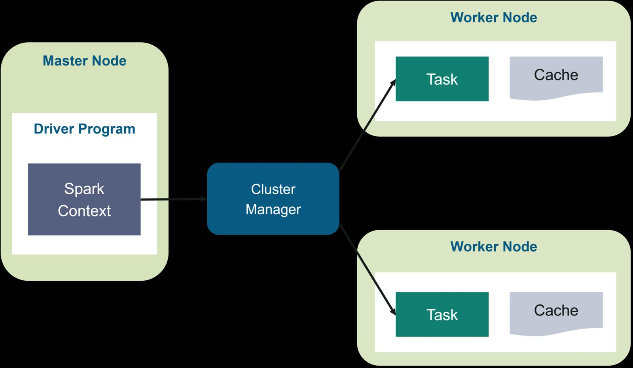
Spark Architecture:
Driver: Controls the app, sends tasks, and collects results
Executors: Run the actual tasks and store data in memory.
Cluster Manager: Allocates resources and manages executors.
Spark follows a Driver-Executor model for fast and distributed data processing.

Slide 14
How will it work?
1. Driver starts the app.
It asks Cluster Manager for resources.
Cluster Manager starts Executors.
Driver sends tasks to Executors.
Executors run tasks and return results.
All steps happen in parallel for fast performance.

Slide 15
Use cases and applications OF SPARK
Log Analysis: Analyze large volumes of log data for insights on system behavior and performance.
Sensor Data Processing: Process real-time sensor data from IOT devices for predictive maintenance or anomaly detection.
Social Media Analytics: Analyze social media data to understand customer sentiment, track trends, and perform targeted marketing
Machine Learning: Train and deploy machine learning models on large datasets for various applications.

Slide 16
Challenges:
Matching schemas between datasets
Null/missing value management
Resource tuning for join operations
Interpreting statistical outliers in cricket data

Slide 17
Future Work
Integrate machine learning models (e.g., classification, regression) to predict match outcomes or player performance.
Add real-time streaming of match data using Spark Streaming.
Expand analysis to include sentiment analysis on social media during IPL matches.
Develop a simple dashboard or web app for live IPL analytics visualization.

Slide 18
Conclusion
This project demonstrated the power of Apache Spark and PySpark in handling large-scale IPL datasets efficiently.
Using in-memory processing and distributed computation, we extracted key insights about team performance, player stats, and match trends.
The analysis proved that big data tools like Spark can bring real value in the field of sports analytics.

Slide 19
References
PySpark Documentation
Kaggle IPL Dataset
Apache Spark Official Site-
https://spark.apache.org/documentation.html

Slide 20
Thank you

